Slide 1
Quality Induction
James Walker & Co Ltd
Manufacturing Business Unit – Cockermouth, Cumbria, UK

Slide 2

What is Quality?
Quality:
Is about meeting all the requirements & expectations of customers.
Quality Management:
Is defining the methods by which quality will be achieved. This can be by introducing initiatives to promote quality or defining how the following aspects of quality are achieved : (QC / QA)
Quality Control.
All those daily activities concerned with checking & reviewing work that has been done. ‘Detecting’ error rather than ‘preventing.’
For example this would include inspection, testing & sampling.
Quality Assurance.
Concerned with how quality can be designed into a product or a process to minimise / reduce / prevent any defect. A well planned QA system should reduce the amount of Quality Control activity.

Slide 3

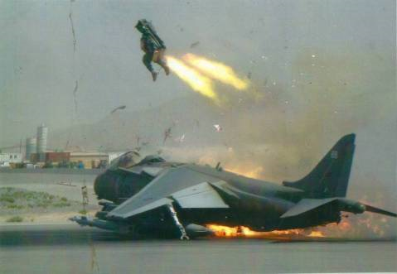
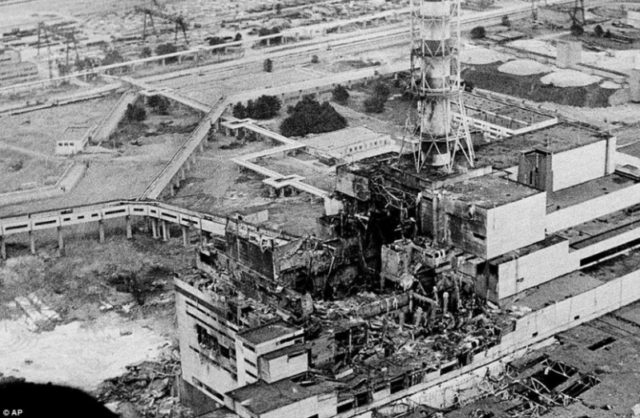
Why is Quality important?
We supply into industries with extremely high risk and critical applications…
BP Gulf of Mexico Disaster
Ejector seat activation
Chernobyl Nuclear Disaster

Slide 4
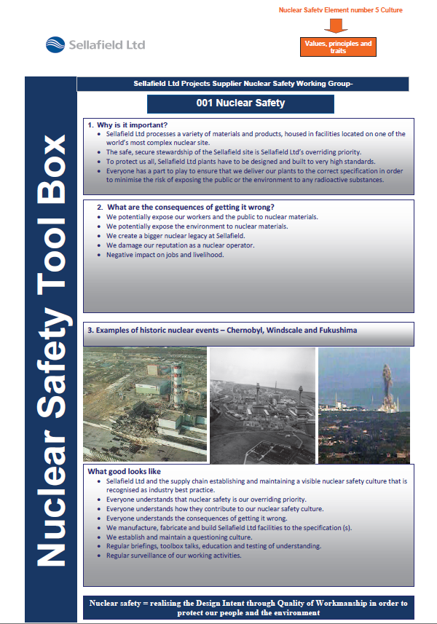
Nuclear Safety Culture
1. Everyone is personally responsible for nuclear safety.
2. Leaders demonstrate commitment to safety.
3. Trust permeates the organisation.
4. Decision-making reflects safety first.
5. Nuclear technology is recognised as special and unique.
6. A questioning attitude is cultivated.
7. Organisational learning is embraced.
8. Nuclear safety undergoes constant examination.

Slide 5
Nuclear Safety Culture
Why is it important?
To Protect us all, Nuclear Sites have to be designed and built to the highest standards
Everyone has a part to play ensuring our parts we deliver to a nuclear plant are to the correct specification in order to minimise the risk of exposing the public (You) or the environment to any radioactive substances
Important: When 10 CFR 21 article 10 of section 1 is applied - in the event of any discrepancy between the technical requirements of the procurement documents and those products and services that have already been supplied, we must inform the customer immediately by the use of our internal QPD88 procedure.

Slide 6
Nuclear Safety Culture
What are the consequences of getting it wrong?
We potentially expose workers and the public to nuclear materials
We potentially expose the environment to nuclear materials
We damage our customers and our reputation
Negative impact on jobs and livelihood.

Slide 7
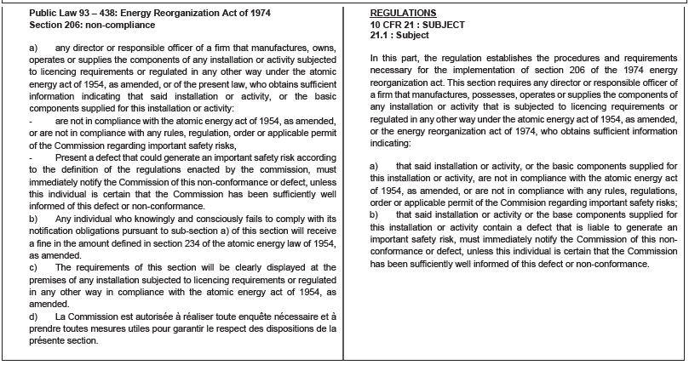
Control of Non-Conforming product
10 CFR PART 21 - James Walker and employee responsibility
All persons with knowledge of or having heard of a defect or non-conformance detected in the manufacture of any product or in the supply of the related services, are required to immediately communicate this information to the current site Quality Manager.
These requirements are applicable to all products and services across site and may be subject to recall in line with internal procedure QPD88 – Control of non-conforming product

Slide 8
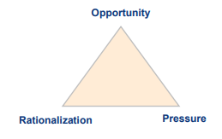
Counterfeit, Fraudulent and Suspect Item (CFSI)
DEFINITIONS:
Counterfeit: imitation or alteration of a legal product without legal right or imitation with the purpose of passing false copy for authentic / genuine without authority
Fraudulent: Intentional misrepresentation to deceive, incorrect identification, falsified or inadequate certification, or used / defective items sold as new
Suspect: Items suspected of being counterfeit or fraudulent. Legally, may not be appropriate to call an item counterfeit / fraudulent unless verified, and conclusive investigation might be very costly.
There are 3 motivations for an individual or company to commit fraud:
Opportunity: use of the gaps in a system, for example, ineffectiveness or controlled absence
Rationalization: moral justification which allows acceptance of the act: survival of the company, preservation of the item, technical "self-importance“
Pressure: difficulties with which the actors are confronted: deadlines (extensions), costs, and technical complexities

Slide 9
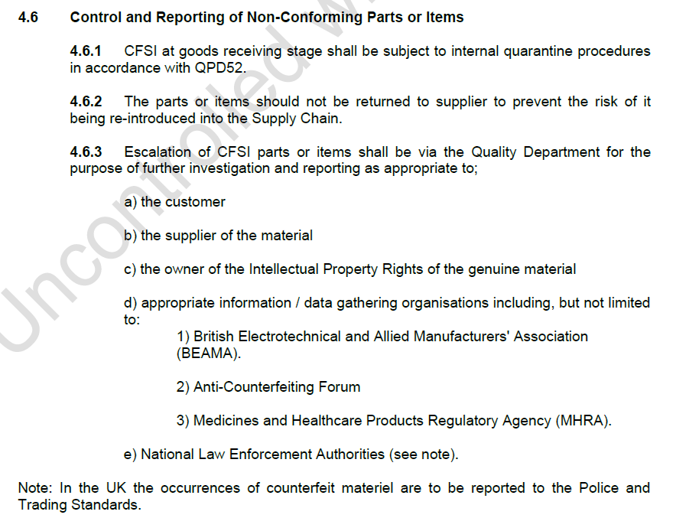
Counterfeit, Fraudulent and Suspect Item (CFSI)
We recognise that counterfeit and fraudulence is a serious global issue, and we have taken a variety of measures to mitigate and prevent CFSI from products delivered to our customers:
Management responsibility
Competence, training and awareness
Control of suppliers
Internal testing and verification
Any suspicion of CFSI shall be reported to the Quality Department for further investigation and reporting as per internal procedures.
Extract from QPD02 Rev 1

Slide 10
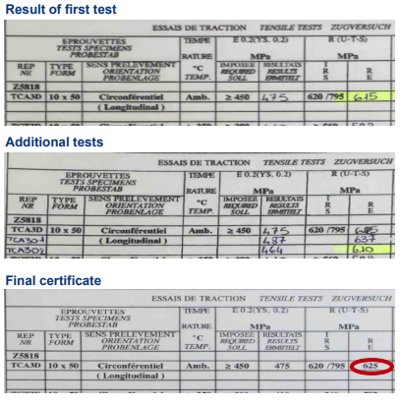
Example of fraud
Intentional modification of a record / certificate, which no longer reflects the reality of the product
Use of a stamp or signature of a person authorised to make an operation, by a person not authorised
Intentional non-declaration of non-compliant product
Use of unrepresentative parts or deliberate modification of normal conditions, to favour acceptance, tests, or test results
IMPORTANT: Always ensure you maintain control of your stamp as this links back to your approval and authority to verify a task or record.

Slide 11
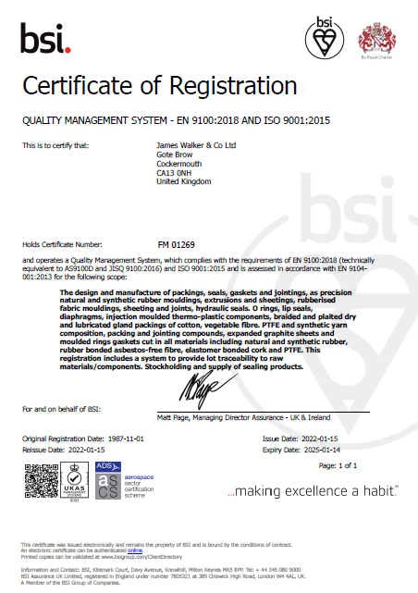
Quality Management System Approval
Accredited to BS EN9100:2018 – Quality Management Systems – Requirements for Aviation, Space and Defence Organizations.
This standard gives the requirements for what the organization must do to manage processes affecting quality of its products and services.
Our accreditation is maintained through annual assessments conducted by the British Standards Institute (BSI)
We also have an internal audit team conducting regular audits to ensure compliance against the standards as well as our own internal procedures.

Slide 12
Employee Responsibilities
Carry out activities and tasks as trained
Undertake job carefully and sincerely
Understand process and product requirements before performing work
Report unsafe acts, near misses and bad quality practices
Contribute to improvement initiatives from Health, Safety, Environmental and Quality perspectives
Take ownership and accountability for Quality
if in doubt ask!

Slide 13
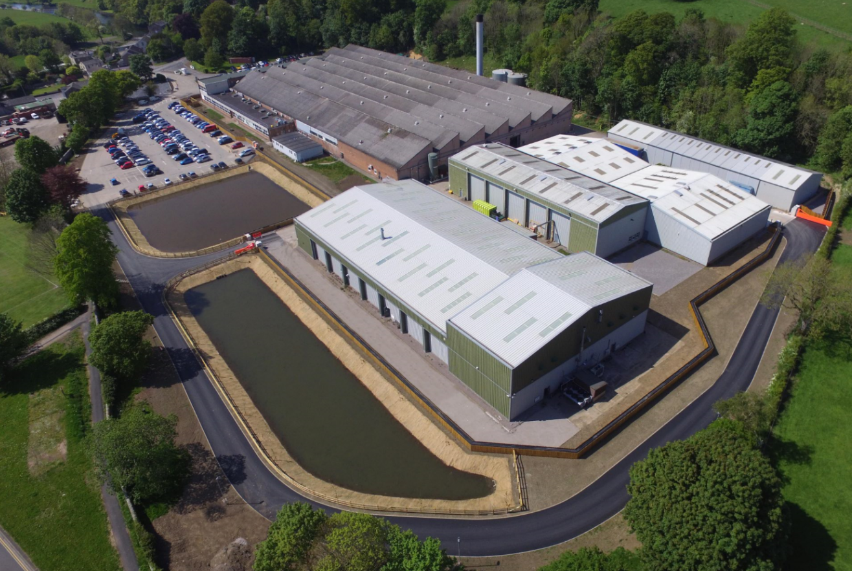
James Walker Cockermouth Site
Site opened in 1969
James Walker’s primary manufacturing site and Centre of Excellence for Elastomer
Site size - 4.2 hectares (uncovered), 1.5 hectares (covered).
410 employees (at latest headcount)
24 hour operation/ 5 days per week across 3 shift pattern.

Slide 14
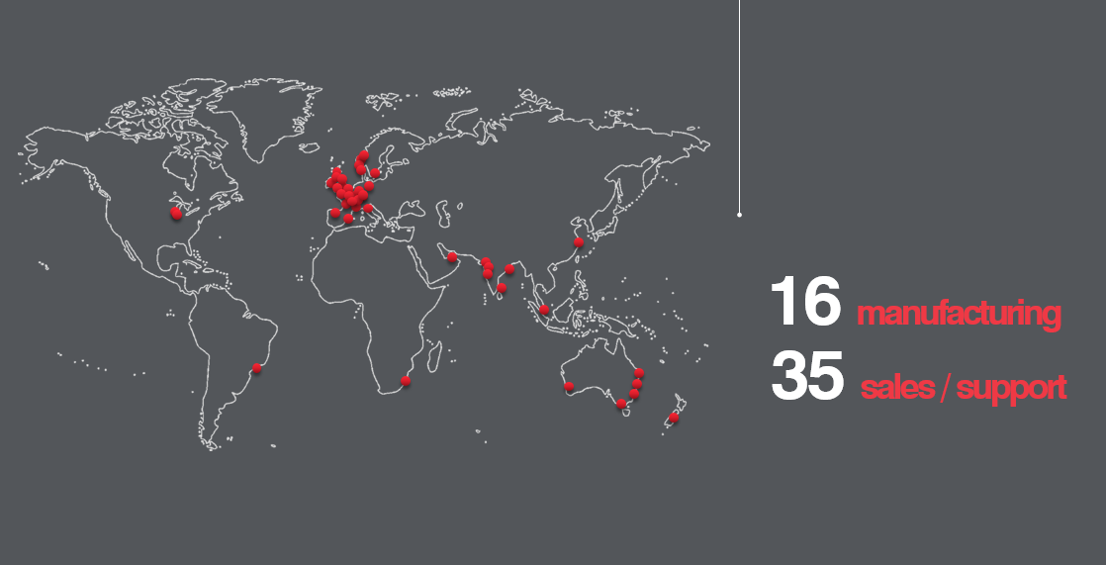
James Walker Locations

Slide 15
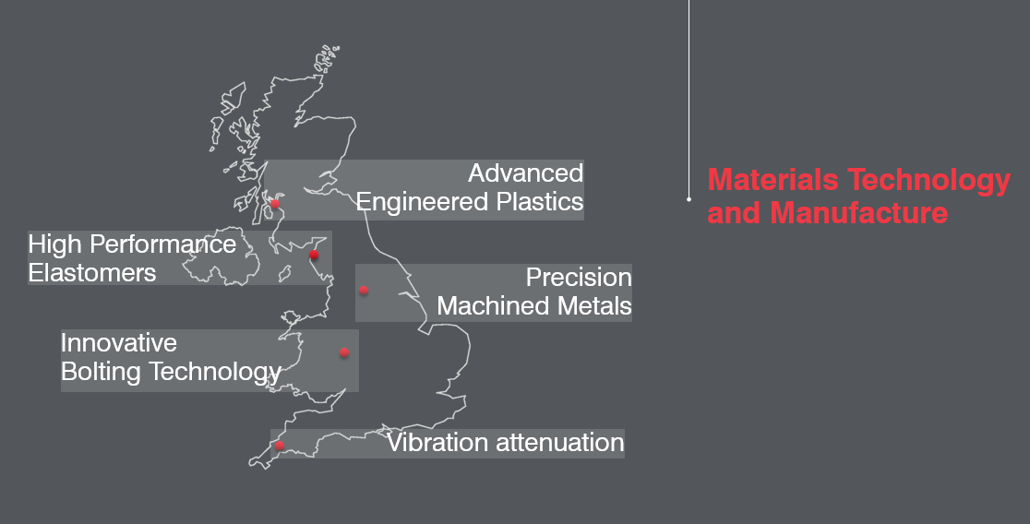
Centres of Excellence

Slide 16
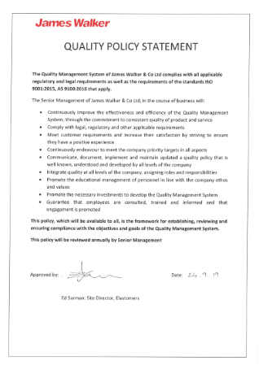
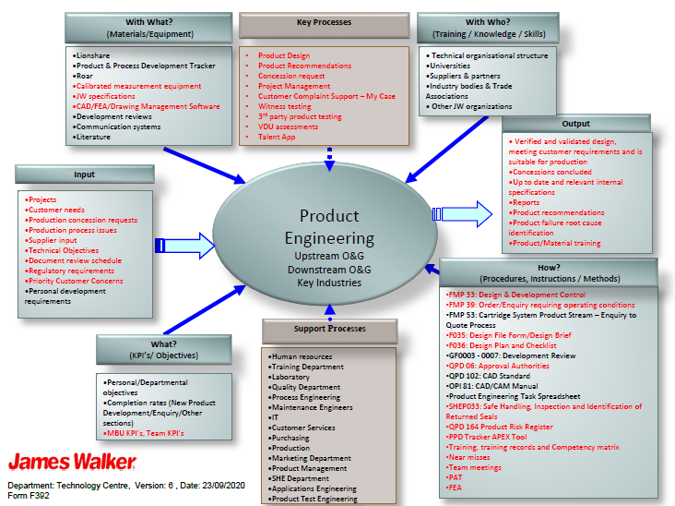
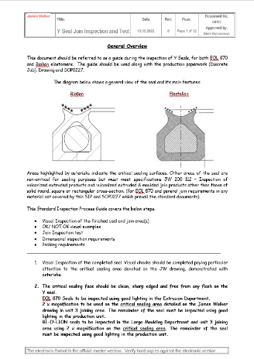
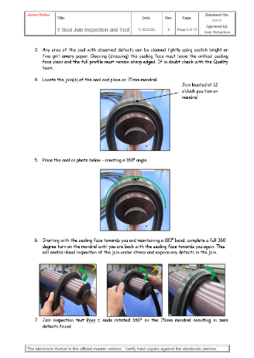
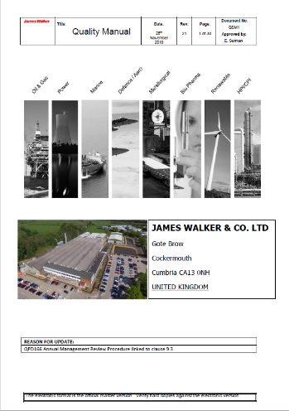
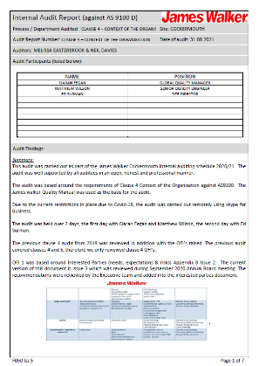
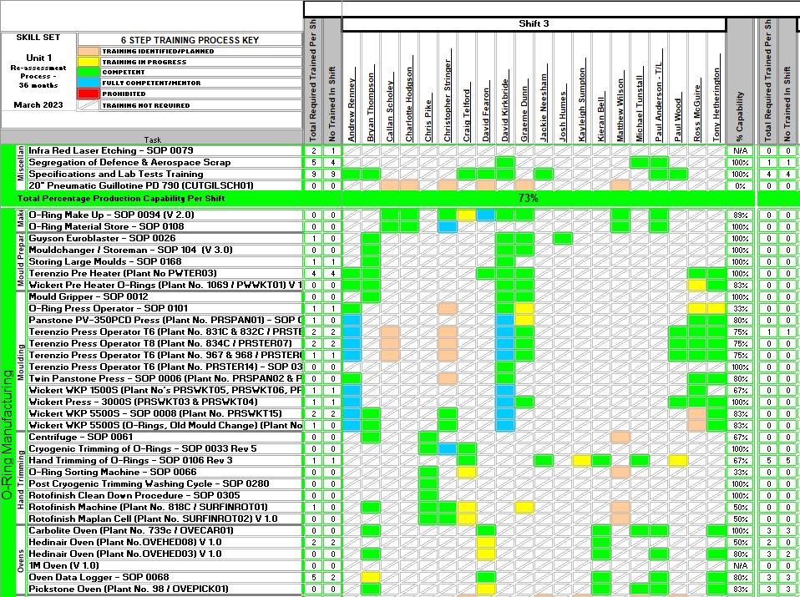
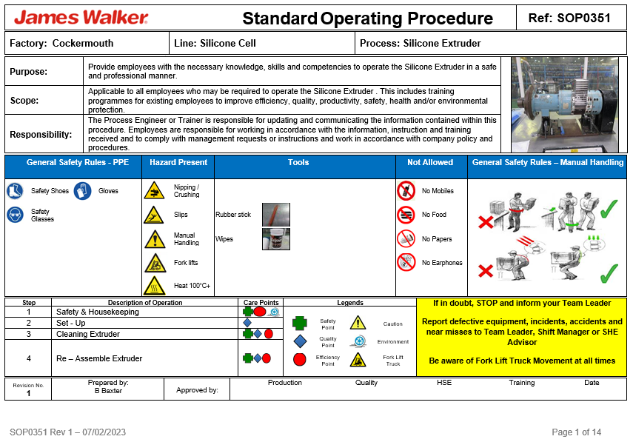
Quality Management System

Slide 17
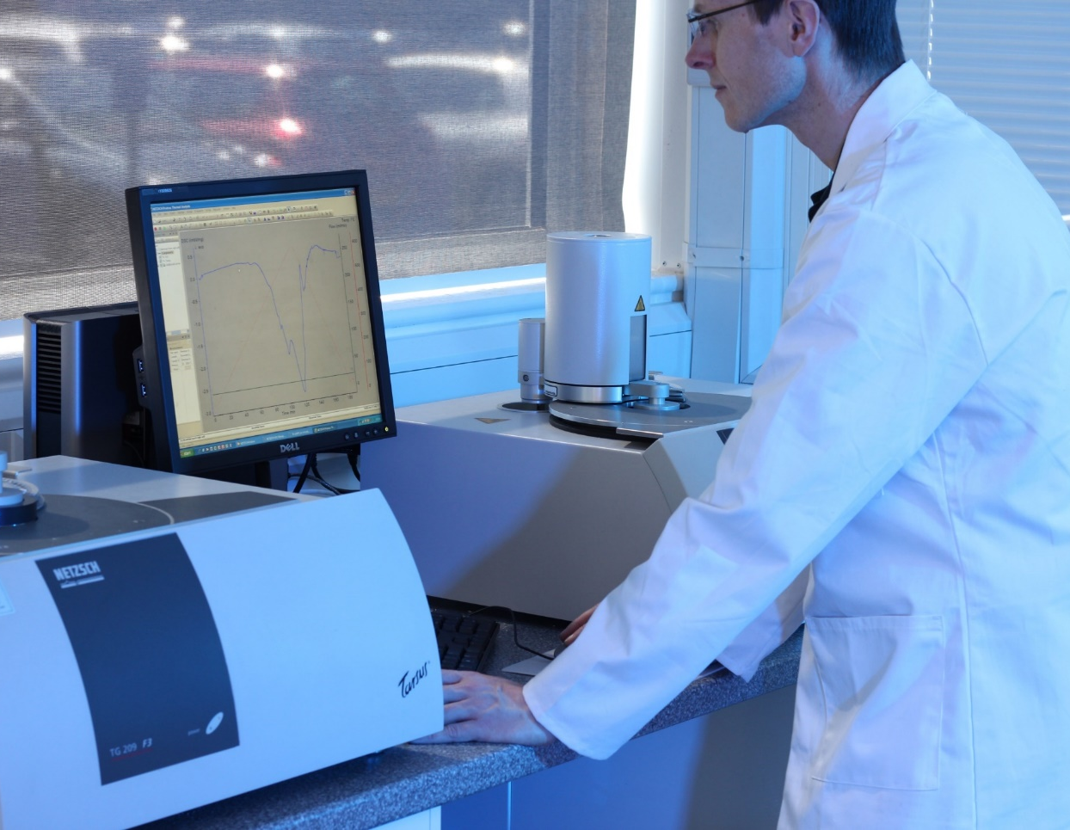
Quality with full traceability
End to end traceability from the first mix of compound
Best in class materials technology
Application design – bespoke parts & materials
In house material and product testing capability
100% visual inspection as standard for all items manufactured

Slide 18
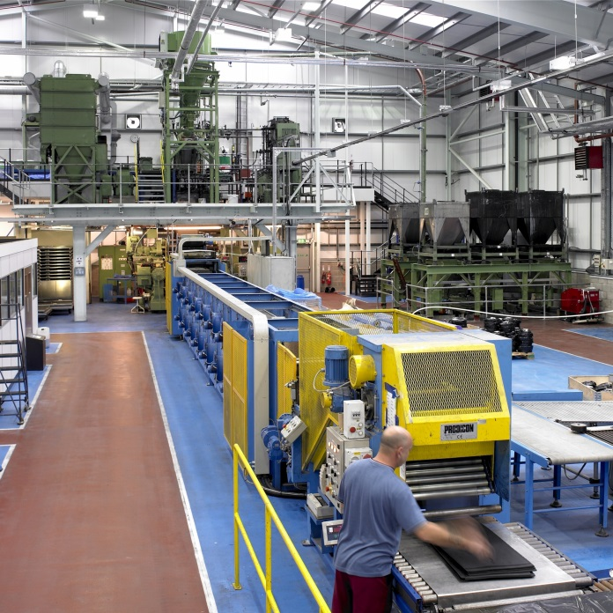
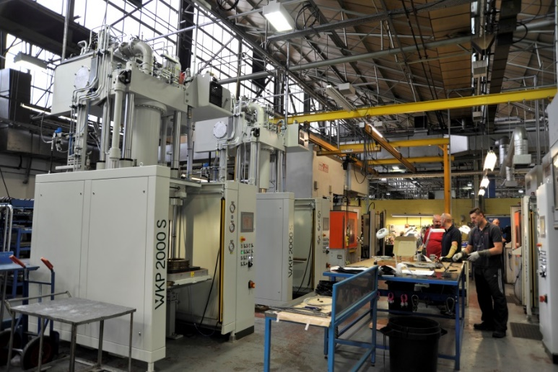
Elastomers Centre of Excellence
Highly Integrated Capabilities and Operations:
Application Design
Materials Technology
Elastomeric Compound Mixing
Tooling Design and Manufacture
Elastomer Moulding Processes
Extensive Product Testing
Stockholding and Logistics
Compression Moulding up to 2.2 Metre Endless Diameter

Slide 19
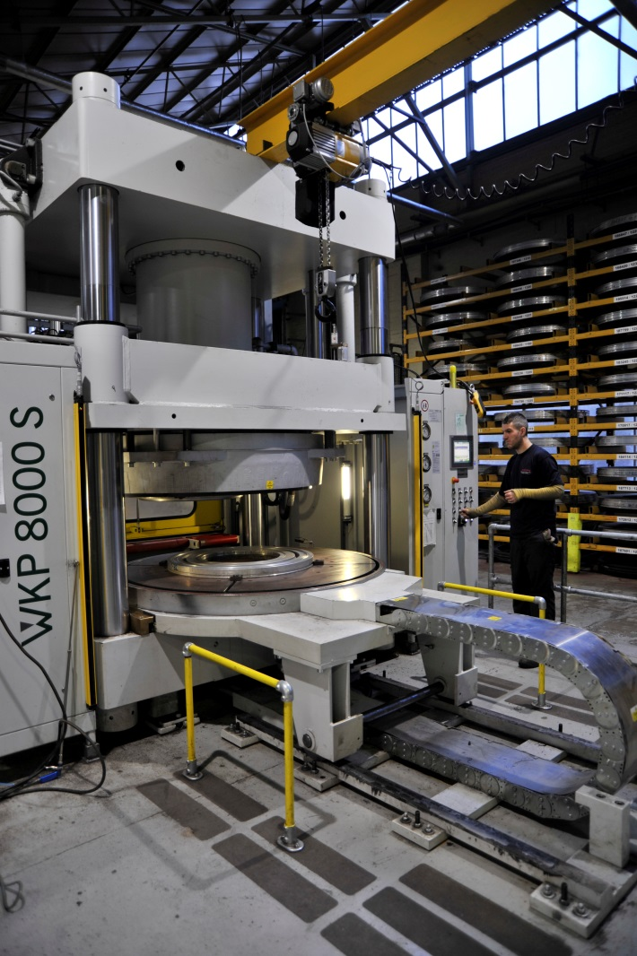
Cockermouth Manufacturing Business Unit
Extremely High Variety Operations:
Over 650,000 Individual Items
Over 10,000 Customer Accounts Globally
Over 50,000 Moulding Tools
Whatever Batch Quantity is Needed:
We regularly manufacture 1 off!
We manufacture the quantity that the customer requires
Generally – High Variety/Low Volume Customised Manufacture

